Slide 1
WEB BASED TRAINING MANAGEMENT SYSTEM
Summer Training Project
Under IRDE, DRDO
Submitted by –
ARPIT SRIVASTAVA – CSE\1119210032
SAHIBA MITTAL – CSE\1119210095

Slide 2
ABOUT IT
Web based application for trainee registration and authenticated manipulation of database online.
Developed using the XAMPP, cross-platform web server solution stack package consisting of Apache HTTP Server, MySQL Database, and interpreters for scripts written in PHP.
Aims at storing, retrieving, updating or deleting the data with different authorizations for different class of users.

Slide 3
Over existing system
Existing system is local system based model.
Students need to fill form manually on paper at location of organization, so lots of paper work which is tedious of course.
Since its not online, the process is limited to the organization premises.

Slide 4
Why web based ??
Accessible from any location with internet facilities.
Eliminate the need of paper registration.
Authenticated and authorized access to data.
Manual work which is time consuming and tedious can be reduced.
User – friendly with GUI interface.
Operation on database can be performed by admin without using actual SQL queries.
Data can be manipulated by admin remotely.

Slide 5
System Modules
Homepage for login (Student,Administrator)
New form to register
Retrieval of information by searching
Update of data by admin
Deletion of any record

Slide 6
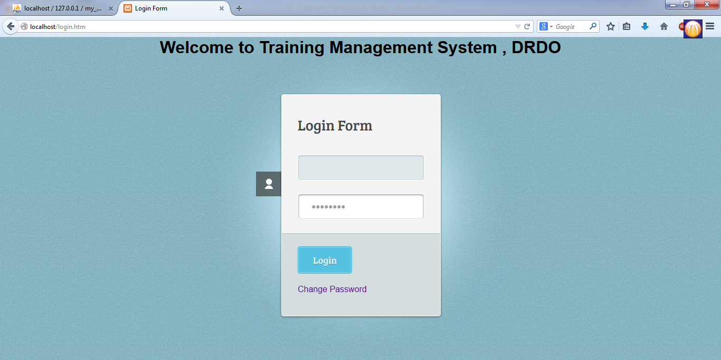
BASIC LAYOUT (Login Page)
Homepage for authenticated login

Slide 7
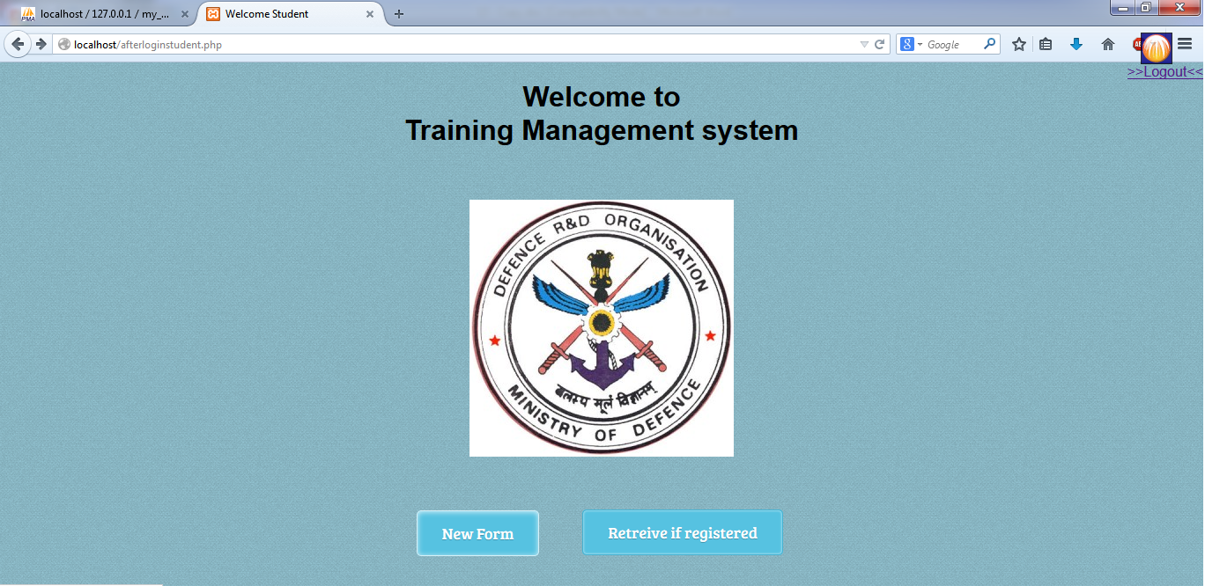
Home page for Student

Slide 8
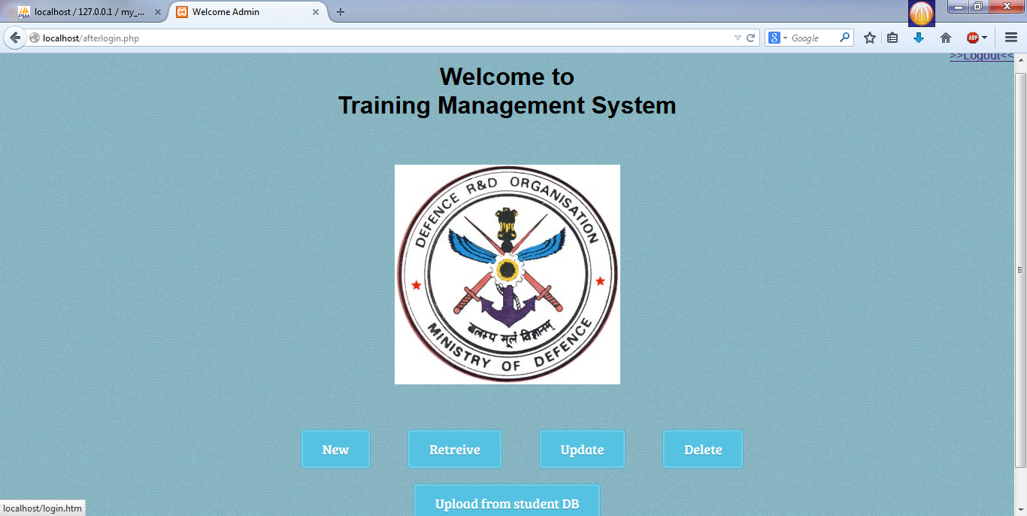
Homepage for Admin

Slide 9
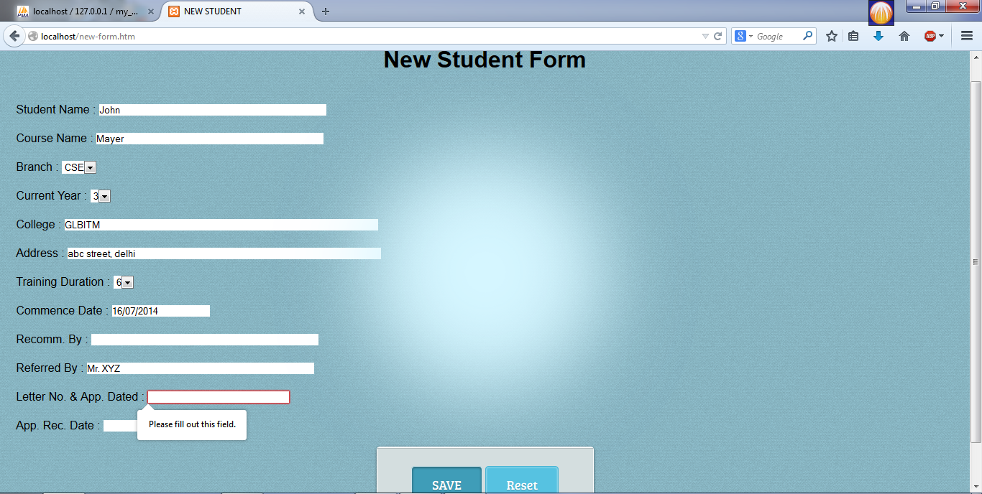
New Form

Slide 10
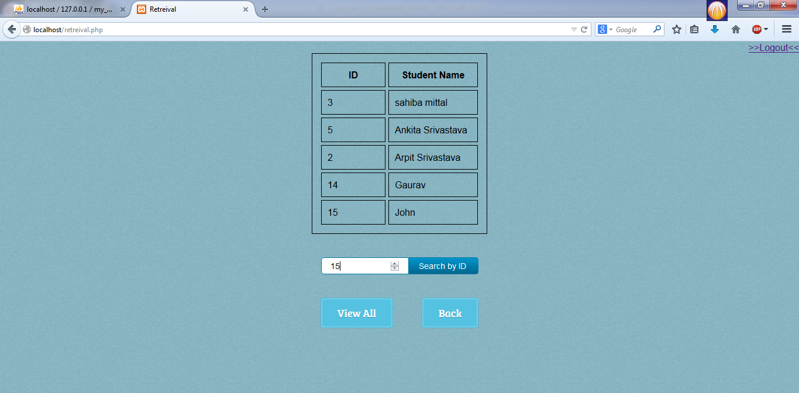
Retrieve Page by searching

Slide 11
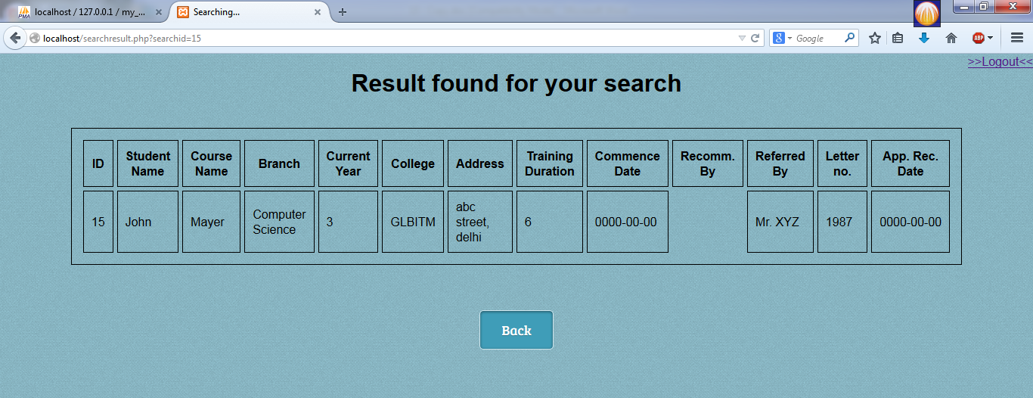
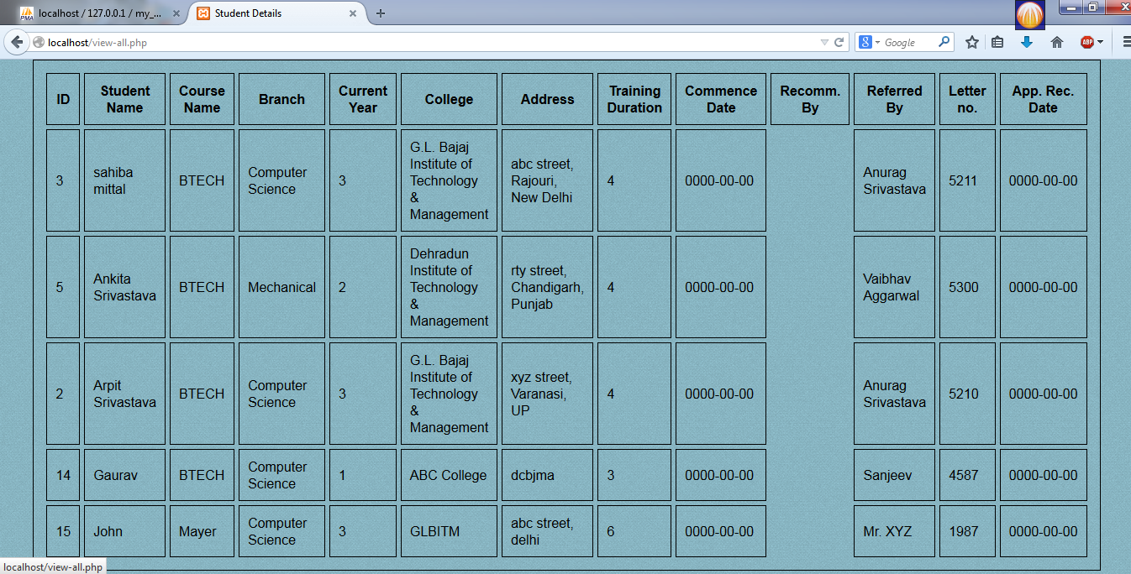
Result for searched ID and view all respectively

Slide 12
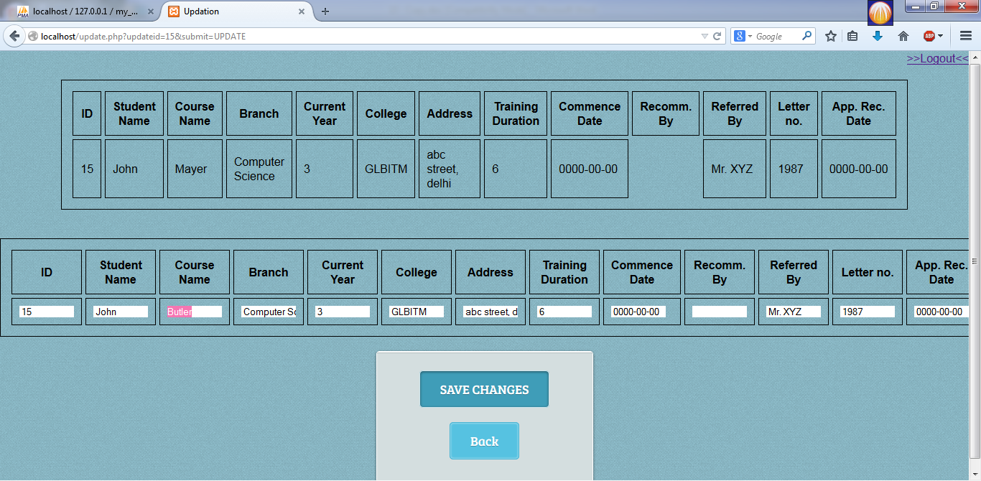
Updation

Slide 13
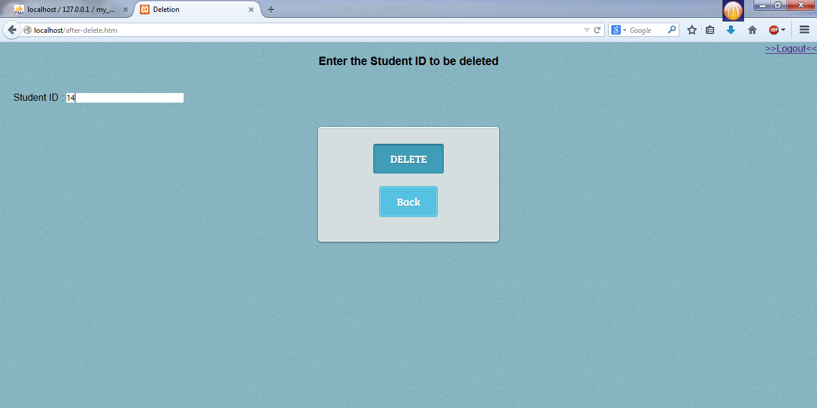
Deletion

Slide 14
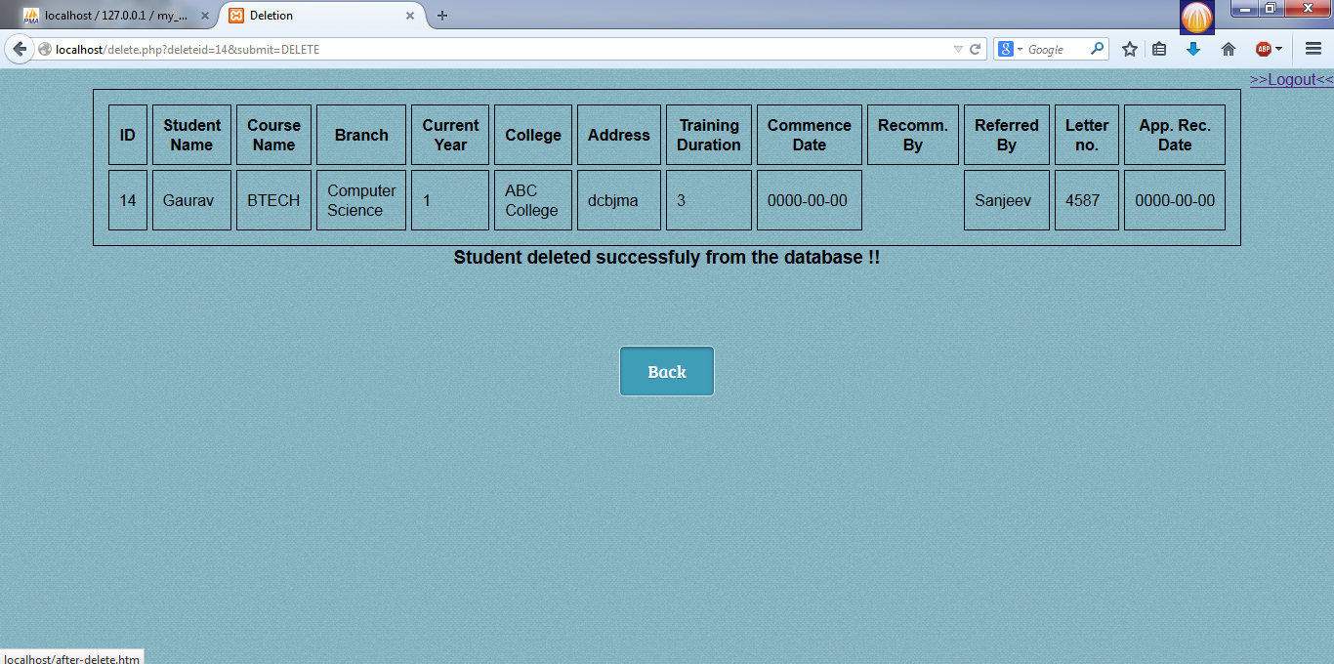
On deletion

Slide 15
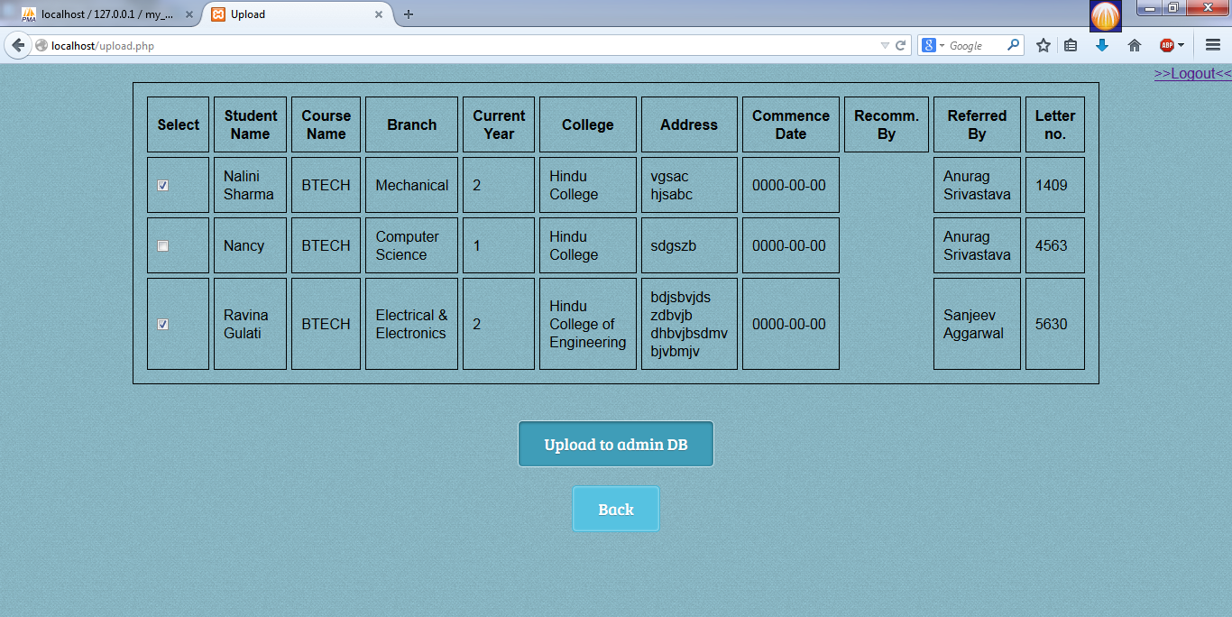
Upload from student to main table

Slide 16
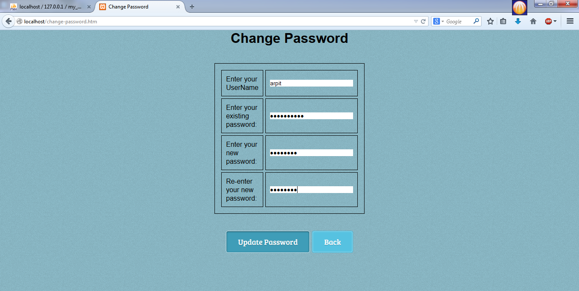
Changing password

Slide 17
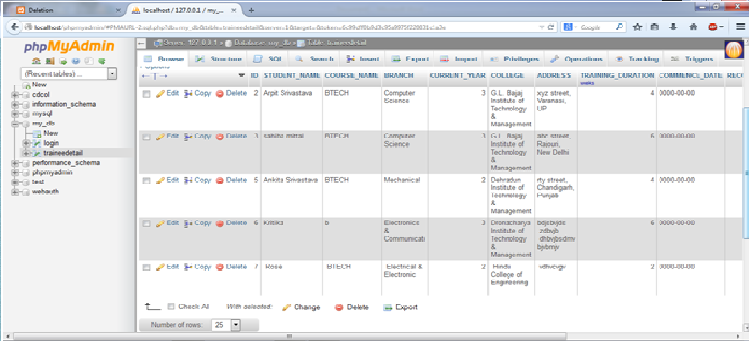
Small look at database on server

Slide 18
CONCLUSION
The Training Management System for organization, developed using PHP, MySQL meets the objectives of the idea of making the local system software a web-based software.
Now the student as well as administrator under authorization can access, manipulate the records from anywhere other than organization without writing SQL queries.

Slide 19
THE END

